Slide 1
Basic HTML Tags
HEADING: <h1>….<h6>
PRAGRAPH: <p>
IMAGE: <img src=“image_location(url)\img_name” >
BUTTON: <button></button>
LINKS: <a href=“link_address”>

Slide 2
LIST: - ORDERED LIST <ol>…</ol> - Types: - “1” - “A” - “a” - “I” - “i” - UNORDERED LIST <ul>…</ul> - Types: - “disc” - “circle” - “square” - “none”

Slide 3
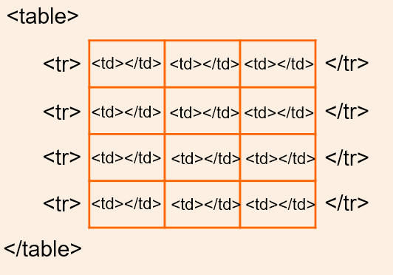
TABLE: <table>…..</table> - <tr> : Table row - <th> : Table Heading - <td> : Table data/cell

Slide 4
FORM: <form>….</form> <input type=“_______”> - text - password - radio - button - checkbox etc…. <textarea>……</textarea> <select> //dropdown list. <option>xyz</option> <option>abc</option> <option>pqr</option> </select>

